Slide 1
What is HTML?
HTML stands for Hyper Text Markup Language
HTML describes the structure of Web pages using markup
HTML elements are the building blocks of HTML pages
HTML elements are represented by tags, Attribute and Content
HTML tags label pieces of content such as "heading", "paragraph", "table", and so on
Browsers do not display the HTML tags, but use them to render the content of the page
These tags can be represents in between angular brackets. Ex:- <tagname>

Slide 2
Structure of HTML
<!DOCTYPE >
<html>
<head>
<title>Page title</title>
</head>
<body>
</body>
</html>

Slide 3
Structure of HTML
The <!DOCTYPE> declaration appears at the top of a web page before all other elements. According to the HTML specification or standards, every HTML document requires a document type declaration to ensure that the pages are displayed in the way they are intended to be displayed. It is not case sensitive.
The <html> element is the root element of an HTML page
The <head> element contains meta information about the document
The <title> element specifies a title for the document
The <body> element contains the visible page content

Slide 4
Example Program
<!DOCTYPE html> <html> <head> <title>Page Title</title> </head>
<body> This is My First Program </body> </html>
Save with .html extension
Run in any browser.

Slide 5
HTML Character Entities
Result | Description | Entity Name | Entity Number
 | non-breaking space | &nbsp; | &#160;
< | less than | &lt; | &#60;
> | greater than | &gt; | &#62;
& | ampersand | &amp; | &#38;
" | double quotation mark | &quot; | &#34;
' | single quotation mark (apostrophe) | &apos; | &#39;
¢ | cent | &cent; | &#162;
£ | pound | &pound; | &#163;
¥ | yen | &yen; | &#165;
€ | euro | &euro; | &#8364;
© | copyright | &copy; | &#169;
® | registered trademark | &reg; | &#174;

Slide 6
HTML Basic tags
<b>
<i>
<center>
<u>
<strong>
<small>
<big>
<sup>
<sub>
Style
Lists
Tables
Forms
Frames
CSS
<p>
<pre>
<h1>….<h6>
<hr>
<br>
<em>
<blockquote>
<a> (hyper link)
<img>
<marquee>
<font>
<meta>
<div>
<span>
&nbsp; (non-breaking space)

Slide 7
HTML Headings and Paragraphs
HTML headings are defined with the <h1> to <h6> tags.
<h1> defines the most important heading. <h6> defines the least important heading:
<h1>, <h2> and <h3> use font size that are larger than that of the default size of text.
<h4> uses the default size.
<h5> and <h6> use smaller sizes
HTML paragraphs are defined with the <p> tag
Syntax:
<p> write some text </p>
LINE BREAK : The break tag is specified <br />
By using this tag the contents displayed in the next line

Slide 8
HTML Headings and Paragraphs
Emphasis tag , <em> specifies that its textual content is special and more browsers use italics for such contents.
The strong tag, <strong> is like a emphasis tag. Browsers often set the content of strong element in bold.
Subscript and superscript characters can be specified by the <sub> and <sup>.
X₂³ + Y₁²
X<sub>2</sub><sup>3</sup> + Y <sub>1</sub><sup>2</sup>

Slide 9
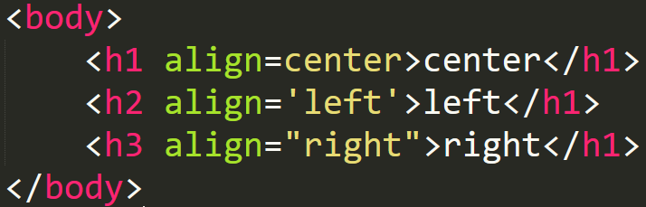
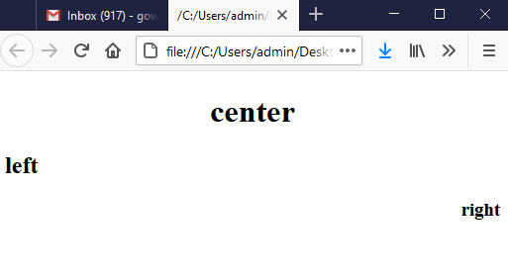
Text alignment
We can align the text at right, left and center.

Slide 10
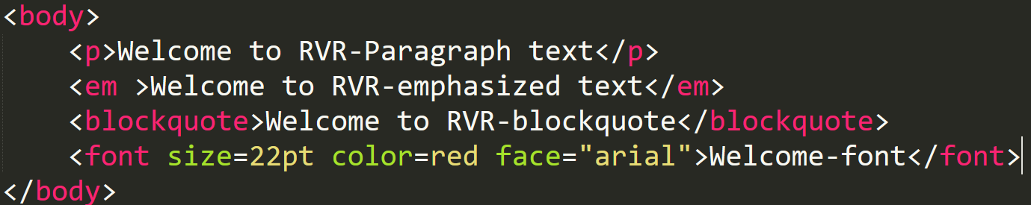
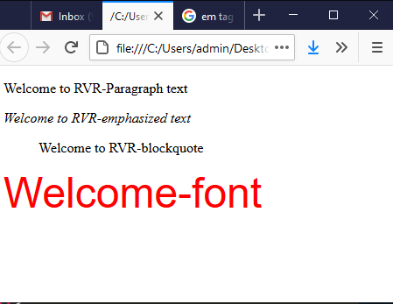
Examples

Slide 11
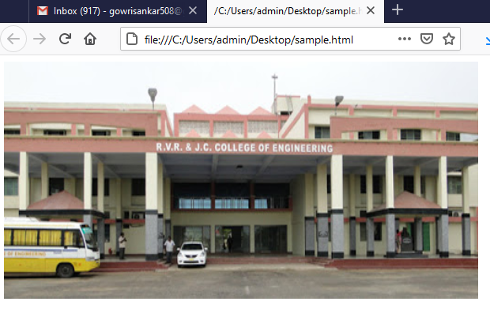
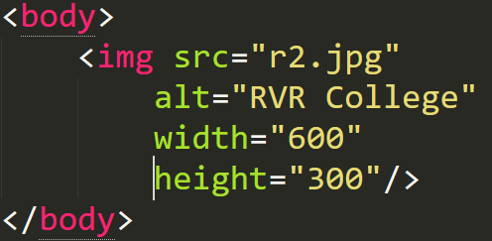
Image Tag
Image tag is an inline tag, specifies an image that is to appear in a document
The image tag represented <img />
The image tag includes mainly two attributes : src and alt
src :specifies file containing the image or source
alt :specifies text to be displayed
Another to attributes width, and height are provided as attributes:

Slide 12
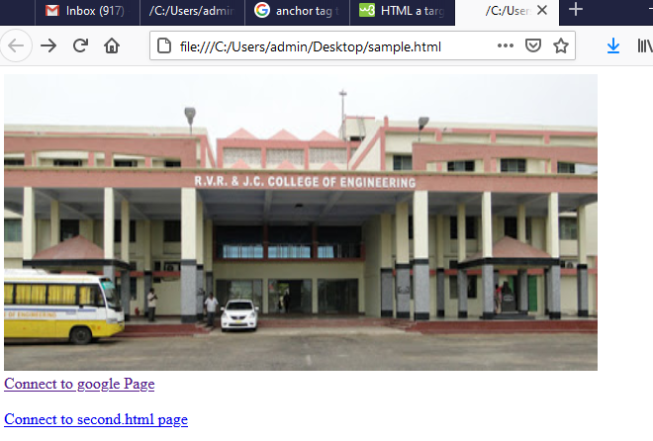
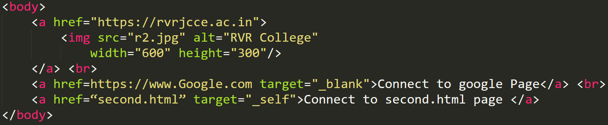
A or Anchor tag
An a or anchor tag is how you make hyperlinks in HTML
Attribute Values
Value | Discription
_blank | Opens the linked document in a new window or tab
_self | Opens the linked document in the same frame as it was clicked (this is default)
_parent | Opens the linked document in the parent frame
_top | Opens the linked document in the full body of the window

Slide 13
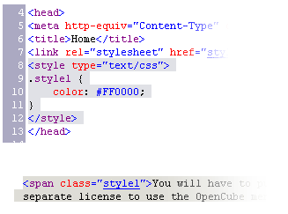

Using <DIV> and <SPAN> Block and Inline Elements

Slide 14
Block and Inline Elements
Block elements add a line break before and after them
<div> is a block element
Other block elements are <table>, <hr>, headings, lists, <p> and etc.
Inline elements don’t break the text before and after them
<span> is an inline element
Most HTML elements are inline, e.g. <a>

Slide 15
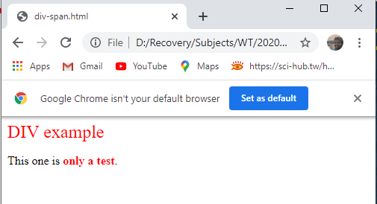
<div> Tag
<div> creates logical divisions within a page
Block style element
Used with CSS
Example:
div-and-span.html
<div style="font-size:24px; color:red">DIV example</div>
<p>This one is <span style="color:red; font-weight:bold">only a test</span>.</p>

Slide 16
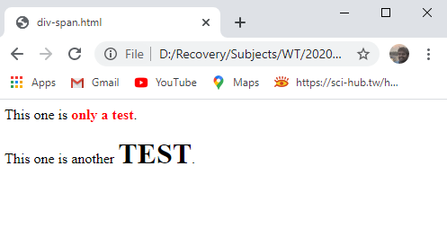
<span> Tag
Inline style element
Useful for modifying a specific portion of text
Don't create a separate area (paragraph) in the document
Very useful with CSS
span.html
<p>This one is <span style="color:red; font-weight:bold">only a test</span>.</p>
<p>This one is another <span style="font-size:32px; font-weight:bold">TEST</span>.</p>

Slide 17
Meta element
The <meta> tag in HTML provides information about HTML Document
<meta> tags always go inside the <head> element.
used to specify character set, page description, keywords, author of the document, and viewport settings.
Metadata will not be displayed on the page.
Metadata is used by browsers (how to display content or reload page), search engines (keywords), and other web services.

Slide 18
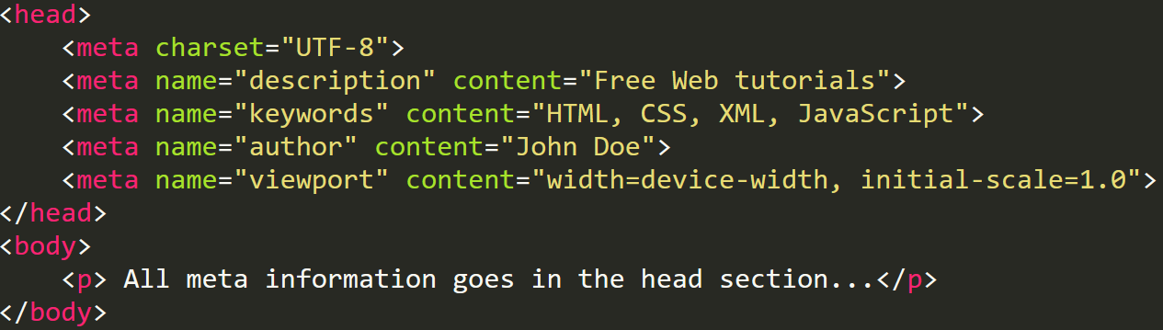
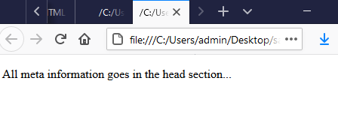
Meta Tag Example

Slide 19
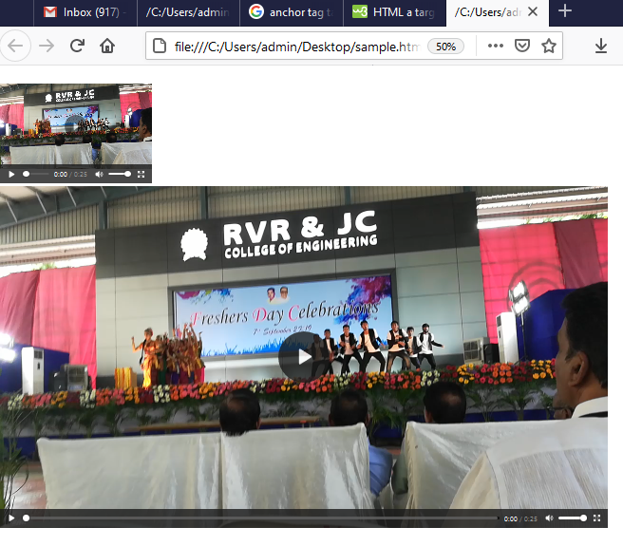
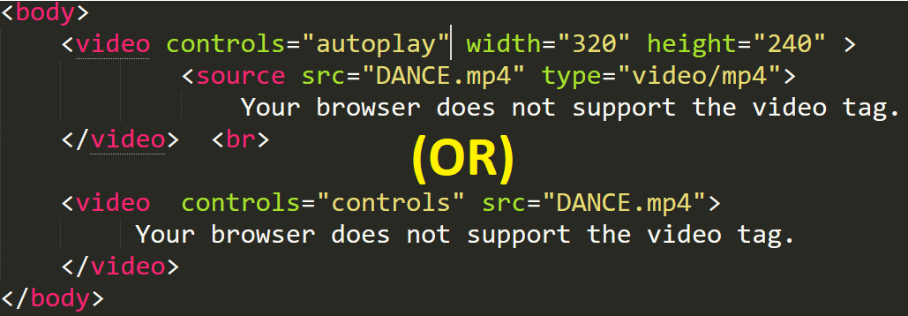
Video Tag
The newly introduced HTML5 <video> element provides a standard way to embed video in web pages.

Slide 20
Marquee tag
The HTML <marquee> tag is used for scrolling of text or image displayed either horizontally across or vertically down your web site page depending on the settings.
marquee>
Attribute | Value | Description
behavior | scroll | Defines the type of scrolling.
 | slide
 | alternate
direction | up | Defines the direction of scrolling the content.
 | down
 | left
 | right
height | pixels or % | Defines the height of marquee.
width | pixels or % | Defines the width of marquee.
hspace | pixels | Specifies horizontal space around the marquee.
vspace | pixels | Specifies vertical space around the marquee.
loop | number | Specifies how many times to loop. The default value is INFINITE, which means that the marquee loops endlessly.
scrolldelay | seconds | Defines how long to delay between each jump.
scrollamount | number | Defines how far to jump.
bgcolor | rgb(x,x,x) | Deprecated − Defines the direction of scrolling the content.
 | #xxxxxx
 | colorname

Slide 21
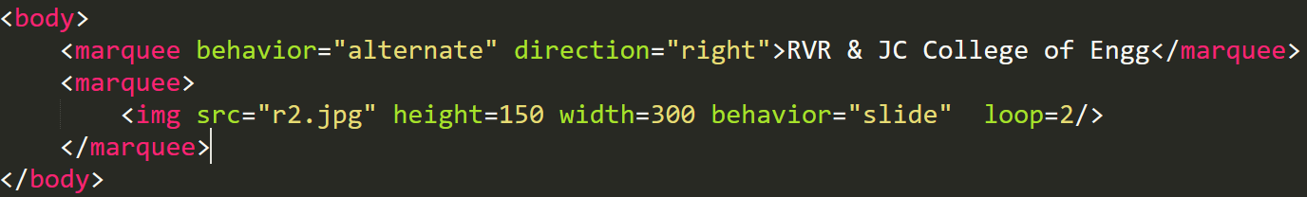
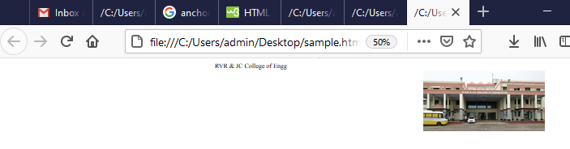
Marquee tag - Example
Syntax:- <marquee>----------------</marquee>

Slide 22
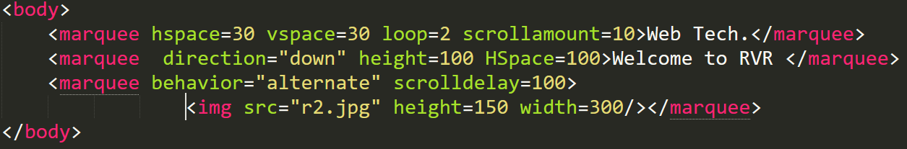
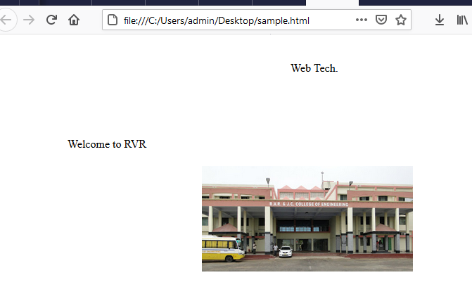
Marquee tag - Example

Slide 23
Lists
There are two types of lists
Unordered list
Ordered list
IUnordered list: The list items will be marked with bullets (small black circles) by default.
An unordered list starts with the <ul> tag. Each list item starts with the <li> tag.
An Ordered list starts with the <ol> tag. Each list item starts with the <li> tag.
Ex: <ul> <ol>
<li>write text</li> <li>Write text</li>
</ul> </ol>
By using these lists you can write nested lists also.

Slide 24
LIST types
The <ul> by default bullet shape is disc (. One)
<ul type=“disc”> : Disc shaped bullets are used
<ul type=“circle”> :Circle shaped bullets are used
<ul type=“square”> :square shaped bullets are used.
The <ol> by default number type
<ol type=“1”> use default number type (1, 2…)
<ol type=“A”> use capital letters for numbering (A, B…)
<ol type=“a”> use small letters for numbering (a, b…)
<ol type=“i”> use roman letters are used (i, ii, iii….)
<ol type=“I”> use roman letters are used (I, II, III….)
<ol start=“3”> use default number start from 3

Slide 25
Tables
A table is a matrix of rows and columns, in which each intersection of row and column is called a Cell. The cells in the top row often contain column labels, those in the leftmost column often contain row labels, most of the rest of the cells contain the data of the table.
The content of a cell can be almost any document element, include text, headings, horizontal rules, images, and nested tables.
Syn:-
<table border=“3” collaspacing=0 width=73% height=300>
<caption> used for caption of the table
<tr> Representing the table row
<th> representing the table heading
<td> Representing the table data.
<thead>, <tfoot> and <tbody>
</table>

Slide 26
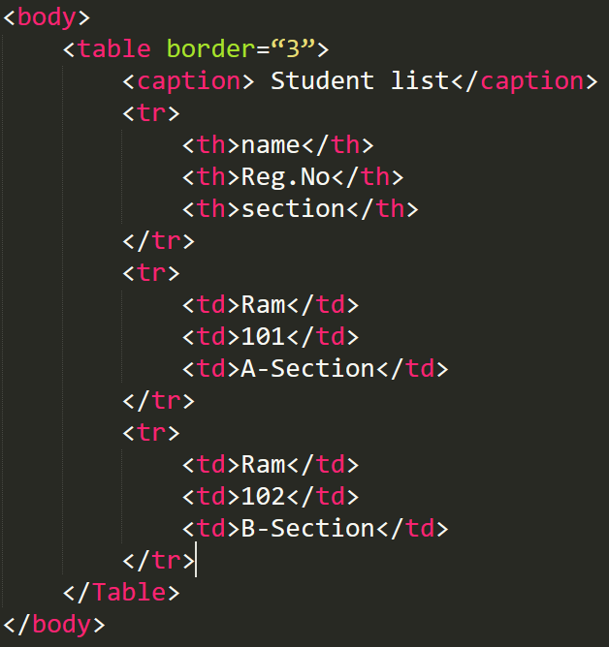
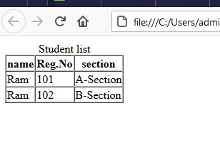
Tables Example

Slide 27
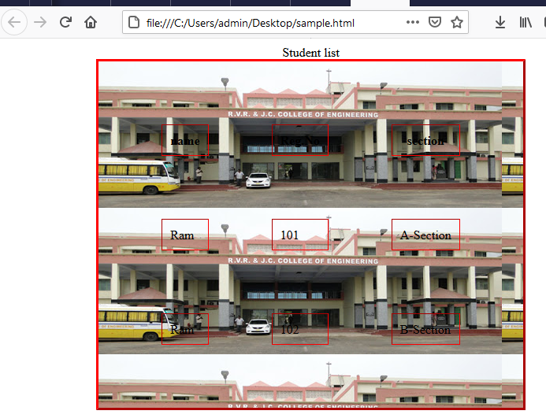
Table – Attributes
Bgcolor:- used to change table background color
Bordercolor :- used to change table border color
Background :- used to set table background image
Width :- width of the table
Height :- Height of the table

Slide 28
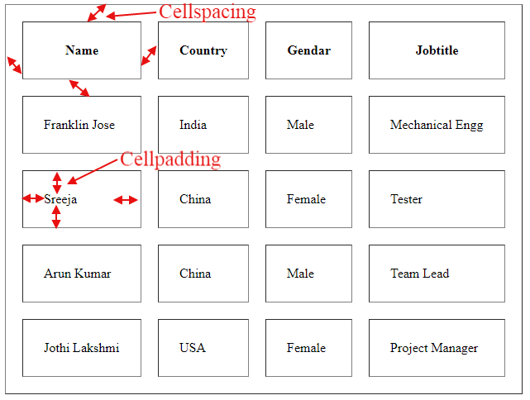
Table – Cellspacing and cellpadding
cellspacing attribute defines space between table cells,
cellpadding attribute represents the distance between cell borders and the content within a cell.

Slide 29
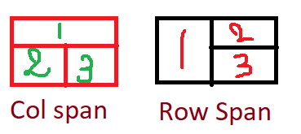
Table -- Rowspan & colspan
The rowspan and colspan are <td> tag attributes. These are used to specify the number of rows or columns a cell should span. The rowspan attribute is for rows as well as the colspan attribute is for columns.
<tr> <td colspan=2> 1 </td> </tr> <tr> <td> 2 </td> <td> 3 </td> </tr> | <tr> <td rowspan=2> 1 </td> <td> 2 </td> </tr> <tr> <td> 3 </td> </tr>

Slide 30
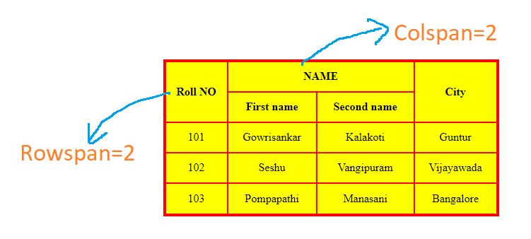
Table – Rowspan and Colspan Example

Slide 31
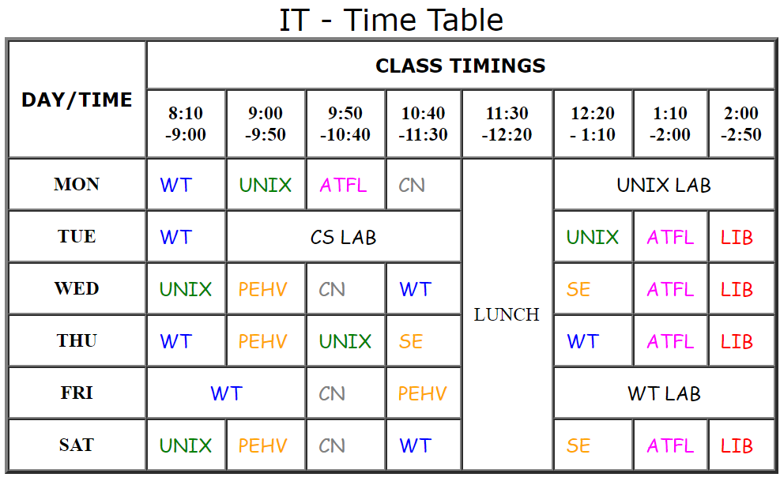

Slide 32
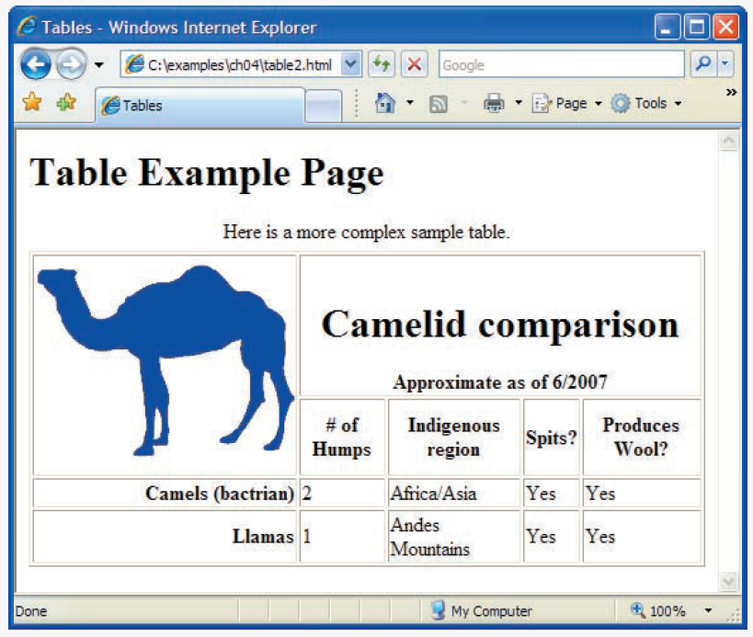

Slide 33
HTML Basic tags
<b>
<i>
<center>
<u>
<strong>
<small>
<big>
<sup>
<sub>
Style
Lists
Tables
Forms
Frames
CSS
<p>
<pre>
<h1>….<h6>
<hr>
<br>
<em>
<blockquote>
<a> (hyper link)
<img>
<marquee>
<font>
<meta>
<div>
<span>
&nbsp; (non-breaking space)

Slide 34
FORMS
An HTML form is a section of a document which contains controls such as text fields, password fields, checkboxes, radio buttons, submit button, menus etc.
An HTML form facilitates the user to enter data that is to be sent to the server for processing such as name, email address, password, phone number, etc. .
Tag | Description
<form> | It defines an HTML form to enter inputs by the used side.
<input> | It defines an input control.
<textarea> | It defines a multi-line input control.
<label> | It defines a label for an input element.
<fieldset> | It groups the related element in a form.
<legend> | It defines a caption for a <fieldset> element.
<select> | It defines a drop-down list.
<optgroup> | It defines a group of related options in a drop-down list.
<option> | It defines an option in a drop-down list.
<button> | It defines a clickable button.

Slide 35
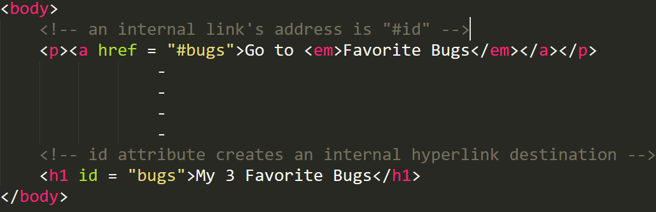
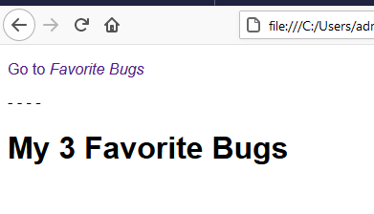
Internal Linking
Internal linking—a mechanism that enables the user to jump between locations in the same document. Internal linking is useful for long documents that contain many sections.

Slide 36
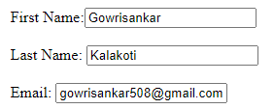
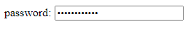

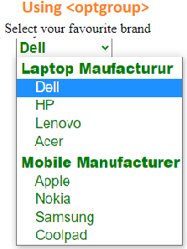
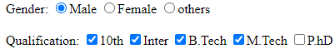
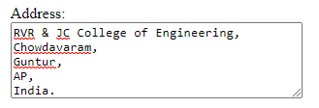
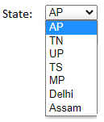
FORM Elements
Label
Input →type=“text”
→type=“password”
→type=“submit”
→type=“clear”
Radio Button
→type=“radio”
Check Box
type="checkbox"
Textarea
Select box (Menu)

Slide 37
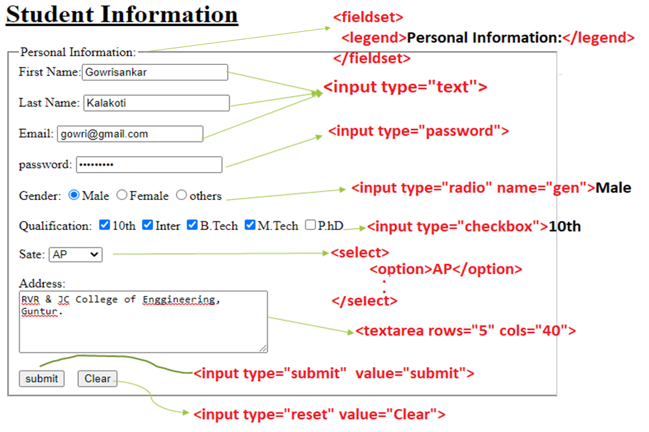

Slide 38
<input type=“submit”> Vs <input type=“button”>
<input type="button" /> buttons will not submit a form - they don't do anything by default. They're generally used in conjunction with JavaScript as part of an AJAX application.
<input type="submit"> buttons will submit the form they are in when the user clicks on them, unless you specify otherwise with JavaScript.
Ex:-
<form action="checkout.html" method="POST“>
<input type="button" name="button1" value="a button">
<input type="submit" name="submit1" value="a submit button">
</form>

Slide 39
Input Attributes
Syn 1:- <input type="text“ id="fname" name="fname">
Syn 2:<input type="image" src="img-sub.gif" alt="Submit" width="48" height="48">
Name, id, Value
Readonly, disable, required, autofocus
Size=20
Maxlength=10
Min=1, max=5
pattern="[A-Za-z]{3}” (should enter 3 chars)
placeholder="123-45-678“,
Step=3 (specifies the legal number intervals [-3,0,3,6,9])

Slide 40
Input Types
<input type="text">
<input type="password">
<input type="radio">
<input type="checkbox">
<input type="submit">
<input type="button">
<input type="reset">
<input type="hidden">
<input type="email">
<input type="image">
<input type="number">
<input type="color">
<input type="date">
<input type="time">
<input type="datetime-local">
<input type="month">
<input type="week">
<input type="range">
<input type="search">
<input type="tel">
<input type="url">
<input type="file">
https://developer.mozilla.org/en-US/docs/Web/HTML/Element/input/password

Slide 41
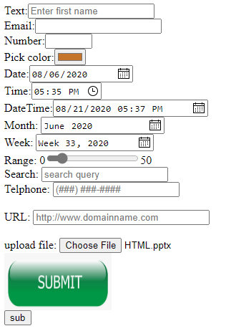

Slide 42
Self-validating input types
input type Format
Color Hexadecimal code
Date yyyy-mm-dd
datetime yyyy-mm-dd
datetime-local yyyy-mm-ddThh:mm
month yyyy-mm
number Any numerical value
email name@domain.com
url http://www.domainname.com
time hh:mm
week yyyy-Wnn

Slide 43
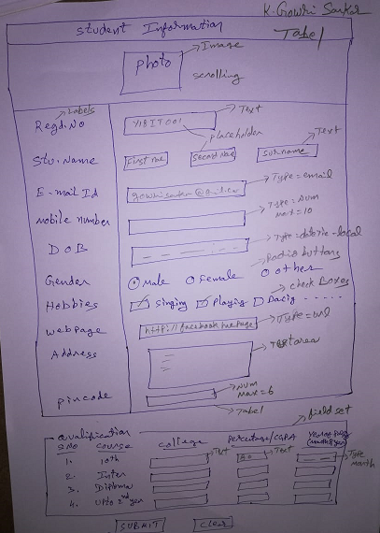

Slide 44
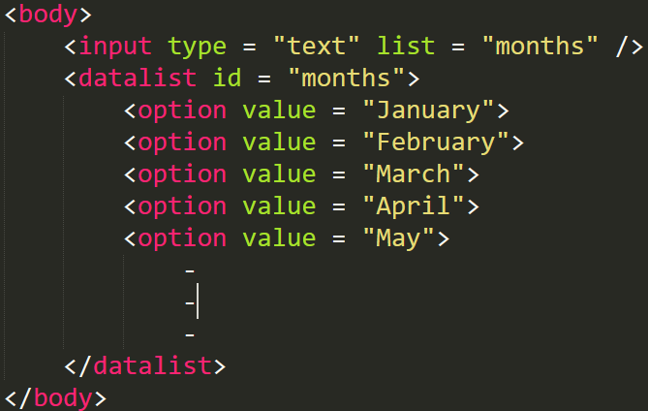
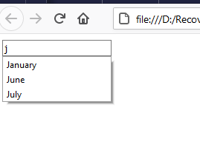
Input and datalist element
and autocomplete attribute
The autocomplete attribute can be used on input types to automatically fill in the user information based on previous input such as name, address or e-mail. You can Enable autocomplete for an entire form or just for specific elements.
Syn:- <form autocomplete = “on”>
The datalist element provides input options for a text input element.
At the time of this writing, datalist support varies by browser.

Slide 45
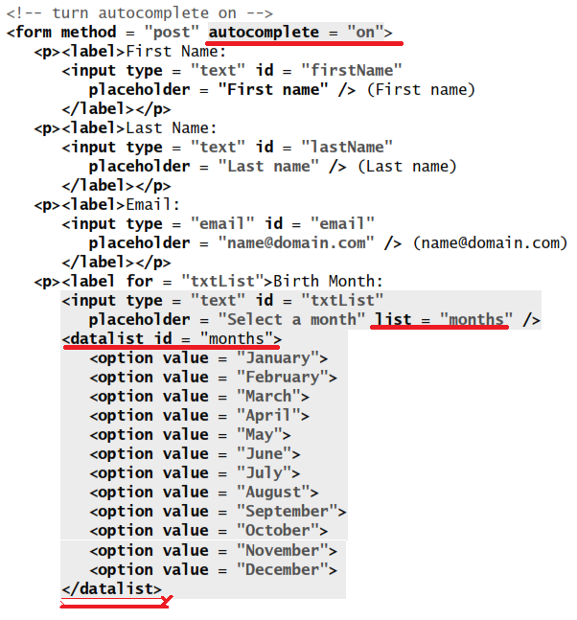

Slide 46
Page-Structure Elements
headers,
footers,
articles,
navigation areas,
asides,
Figures ,
Meter element (visual representation of measure with in a range)
Mark and wbr elements (Mark -> High light text, Wbt -> Warp text)

Slide 47
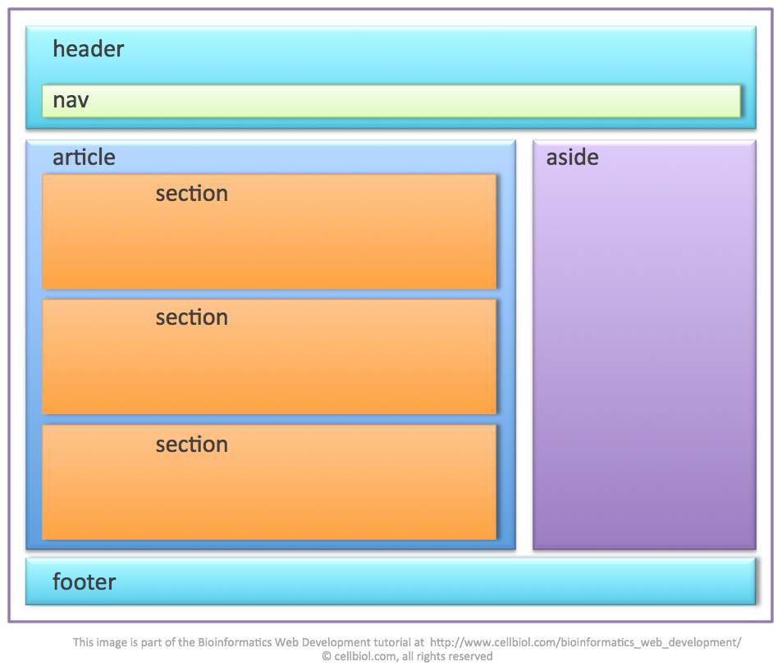

Slide 48
Frames
Frames are used to divide your browser window into multiple sections where each section can load a separate HTML document. A collection of frames in the browser window is known as a frameset. The window is divided into frames in a similar way the tables are organized: into rows and columns.
Syntax:-
<frameset cols="20%,*">
<frame src=“menu.html" scrolling="yes"/>
<frame src=“main-page.html" />
</frameset>

Slide 49
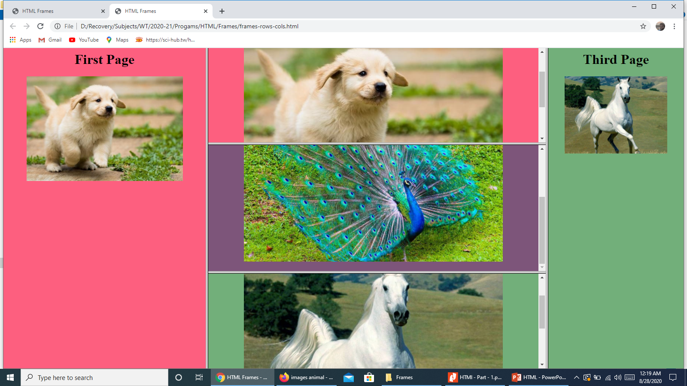
Frames

Slide 50
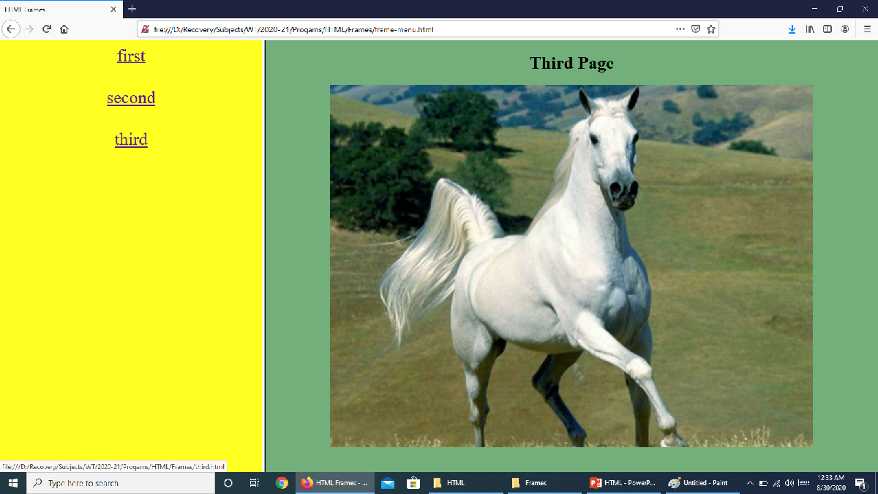
Form-menu.html
<frameset cols = "30%,*">
<frame src = "menu.html" />
<frame name="dynamic" src = "main-page.html" />
</frameset>
menu.html
<a href = "first.html" target = "dynamic"><font size="+3" >first</a>
<a href = "second.html" target = "dynamic">second</a>
<a href = "third.html" target = "dynamic">third</a>
main-page.html
<h1 text-align="center"> Main Page<h1>
third.html
<img src=“horse.jpg" width="80%" height="80%"/>

